Slide 1

ADITYA SLIVER OAK INSTITUTE OF TECHNOLOGY
DEPARTMENT OF COMPUTER ENGINEERING
Under Subject of : Python Programming
Semester -IV
Kaivalya Shah:2302030400121

Slide 2

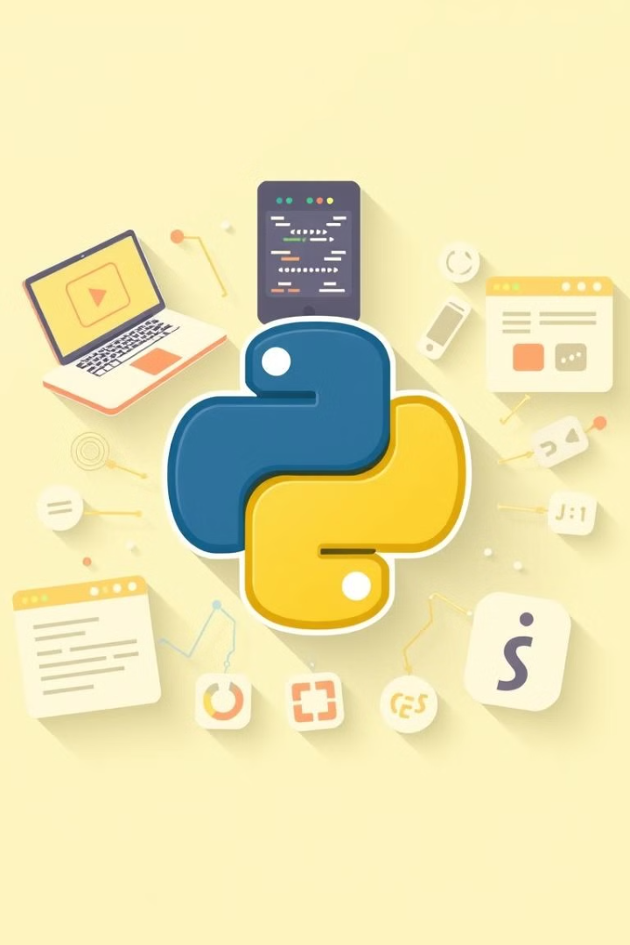
Introduction to Python Web Frameworks
Web frameworks provide structure, tools, and libraries. This simplifies web development. They offer faster development, improved security, and better scalability. They also improve maintainability. Python offers a variety of frameworks for building web applications. Each framework has its strengths and use cases.
Notes:
1

Slide 3
Django: The Batteries-Included Framework
Django is a high-level Python web framework. It follows the "Don't Repeat Yourself" (DRY) principle. It includes an ORM, template engine, and admin interface. It's suitable for complex, database-driven applications. A popular example of a Django project is Instagram.
Key Features
Suitable For
ORM (Object-Relational Mapper)
Complex, database-driven applications
Template Engine
Admin Interface
Notes:
2

Slide 4
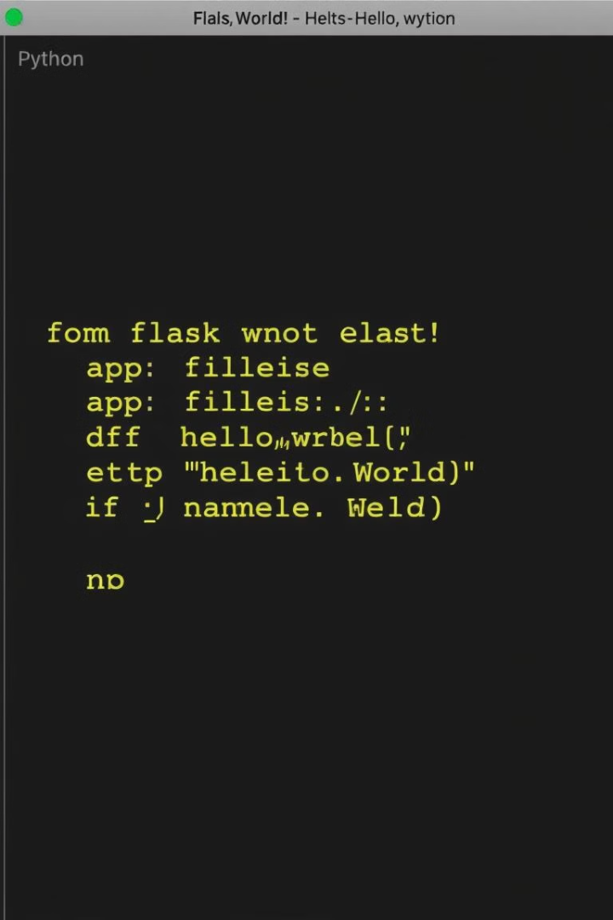



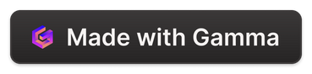
Flask: A Microframework
Flask is a lightweight and flexible microframework. It provides essential tools for web development. Developers can choose the components they need. Flask is suitable for small to medium-sized applications and APIs. A notable example is Pinterest. Flask gives you full control.
Lightweight
Flexible
Minimal core with extensions
Choose components as needed
Suitable for APIs
Great for building RESTful services
Notes:
3

Slide 5
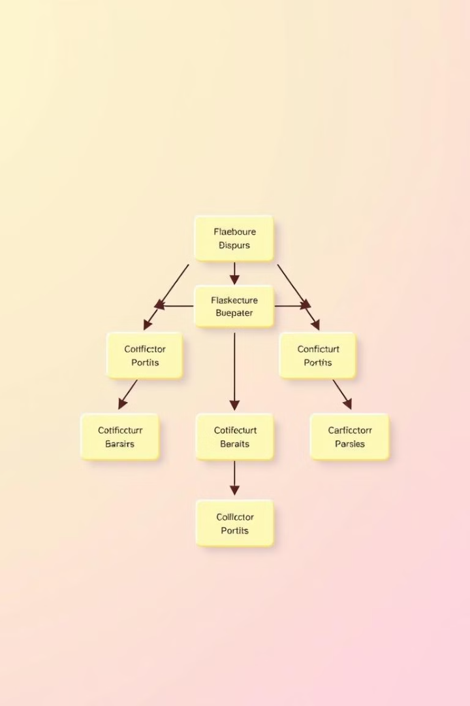
Pyramid: The Goldilocks Framework
Pyramid strikes a balance between Django and Flask. It's flexible and configurable. It is suitable for a wide range of applications. Pyramid follows the principle "explicit is better than implicit". A well-known example of a Pyramid project is Yelp.
Flexible
Scalable
Configurable and adaptable
From small to large applications
Explicit
Clear and maintainable code
Notes:
4

Slide 6
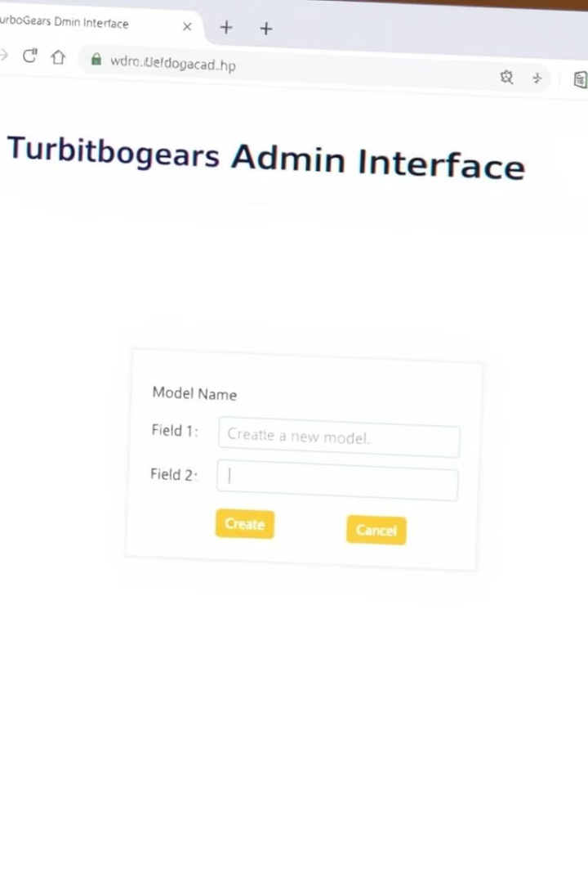
TurboGears: Full Stack MVC Framework
TurboGears combines best-of-breed components. It is a full-stack framework emphasizing rapid development. It uses SQLAlchemy, Genshi, and Repoze. The MVC architecture promotes organized code. It's suited for data-driven applications with complex requirements.
1
Model
2
View
3
Controller
Notes:
5

Slide 7
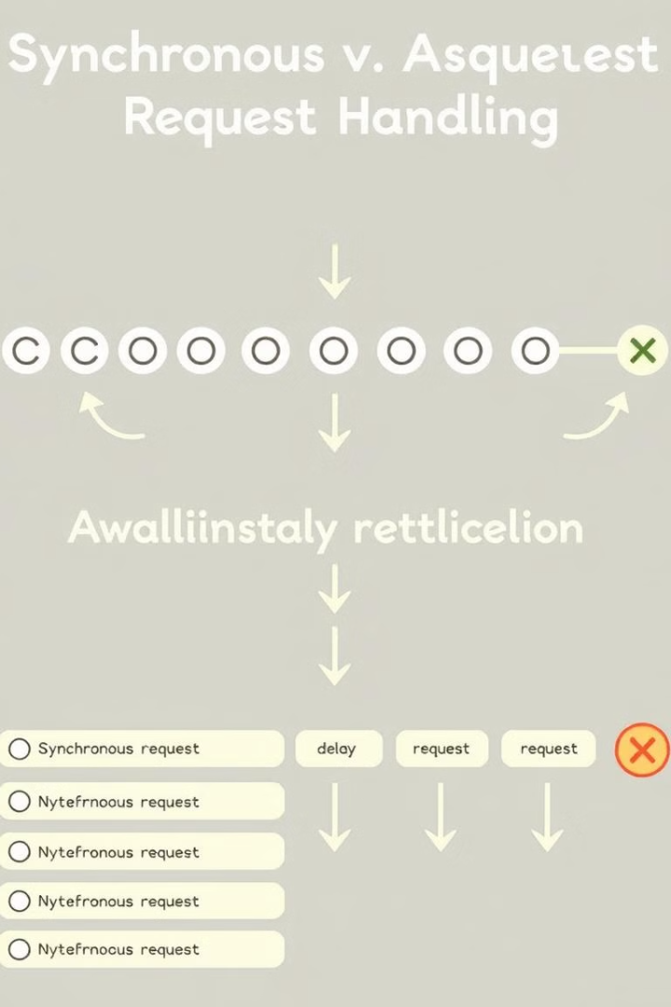


Asynchronous Frameworks: FastAPI and Tornado
Asynchronous frameworks handle many concurrent operations. They use a single thread. Tornado is ideal for long polling and WebSockets. FastAPI is a modern framework for building APIs. FastAPI is based on Python type hints.
Tornado
FastAPI
Notes:
6

Slide 8



Comparing Frameworks: Key Considerations
When choosing a framework, consider project size. Development speed and flexibility are important. Team expertise matters. Assess performance requirements. Evaluate community support. Each factor plays a role in the framework selection process.
2
Team Expertise
1
Project Size
Performance
3
Notes:
7

Slide 9



Microframeworks: Bottle and Falcon
Bottle is a single-file microframework. Falcon is a high-performance framework for building APIs. These are ideal for microservices. They're also useful for prototypes. These are suitable for lightweight applications. These microframeworks simplify web development.
1
Speed
2
Simplicity
3
Efficiency
Notes:
8

Slide 10
Choosing the Right Framework: Questions to Ask
What are your project requirements? What is your team's experience? What are the performance needs? How long will you maintain this app? Asking questions helps. The answers will guide you. Answer honestly to find the perfect fit.
1
Requirements?
2
Team Skills?
3
Performance?
Notes:
9

Slide 11
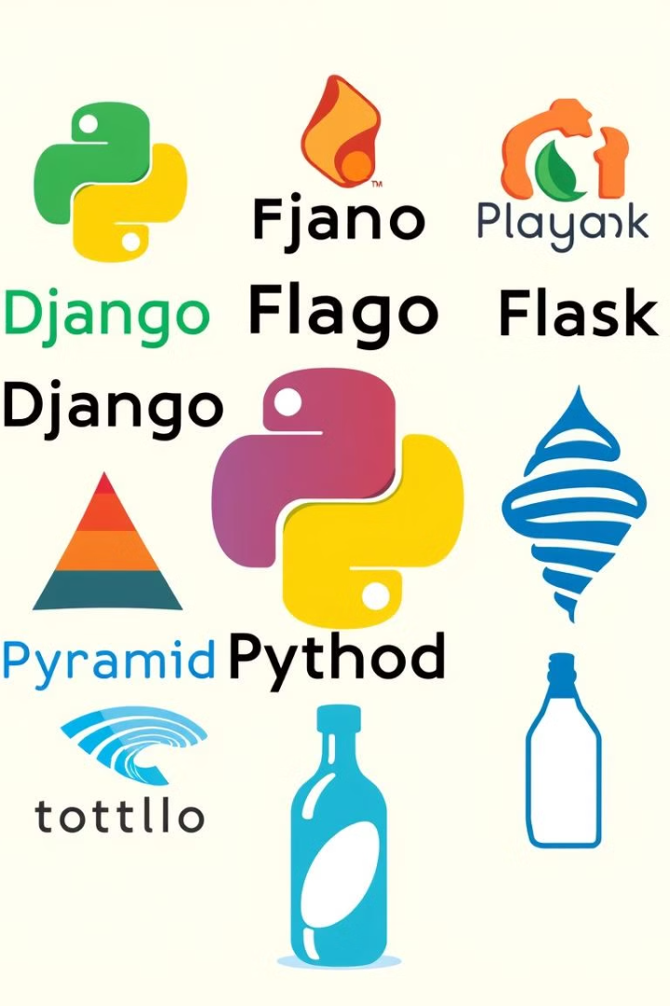
Conclusion: Python Web Frameworks Empower Developers
Python offers many web frameworks for various needs. The correct choice impacts speed and security. Consider project needs. Also consider your team’s expertise. Right framework helps developers. Develop faster and more securely.
100+
5X
Frameworks
Faster
Options Available
Development Speed
99%
Secure
Reduced Vulnerabilities
Notes:
10

Slide 12



any quection..

